Slide 1

Search Spaces
What We Know and How We Know It

Slide 2

Representing a Search Space
The search space (also called the state space) is the set of all possible problem states. Search spaces can be…
Discrete or Continuous
Known or Unknown
Static or Dynamic

Slide 3
Search Graphs
If a state space is known, we can build a search graph to represent the search space (which is discrete) and improve search time.
1
1∙1
2
1∙1
3
1∙1
X
1∙1.4
1∙2
1∙3
1∙1
For dynamic state spaces, we’ll need to update the graph over time.

Slide 4
Graph Representation
The way we represent information impacts agent behavior.
B
class SearchNode:
search_state = None
terrain_weight = 0
neighbors = []
1
A-B-C: 2∙1+2∙1 = 4
A-C: 3∙1 = 3
2
2
10
A
C
1
3
1
3
class SearchNode:
search_state = None
edges = []
class Edge:
endpoint = None
cost = 0
B
A-B-C: 2+2 = 4
A-C: 30
2
2
Or…
1
1
A-B-C: 2+2 = 4
A-C: 21 (1∙1+2∙10)
.5
.5
A
10
C
3

Slide 5

Example: Search Graph for Tiles
def buildGraph(tileMap):
nodes = dict()
for tile in tileMap:
nodes[tile] = SearchNode(tile)
# Go through the nodes dictionary for each key-value (tile-node) pair
for tile, node in nodes:
for neighbor in tilesAdjacentTo(tile):
# Calculate the cost between the tile and its neighbor; add edge.
cost = calculateCost(tile, neighbor)
node.edges.append(Edge(neighbor, cost))

Slide 6
Well-Defined Problems
Often a solution to a problem can be broken into a series of steps.
Some of these are also well-defined problems.
A well defined problem has these features:
Initial state
Set of goal states
State space (reachable states)
1+ Operators (a finite set of steps/actions)
In a well-define problem, we can systematically approach the problem space.

Slide 7
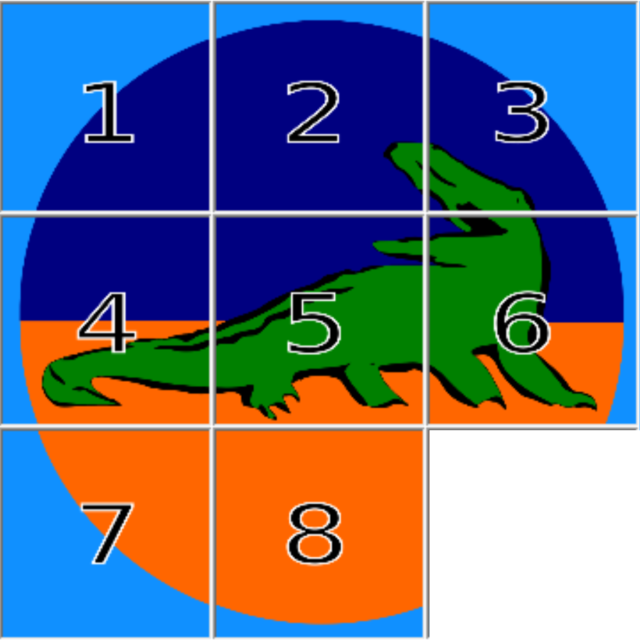
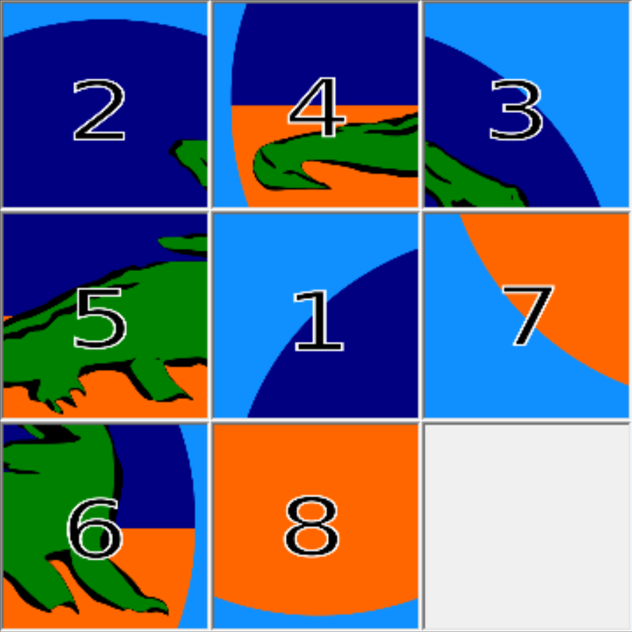
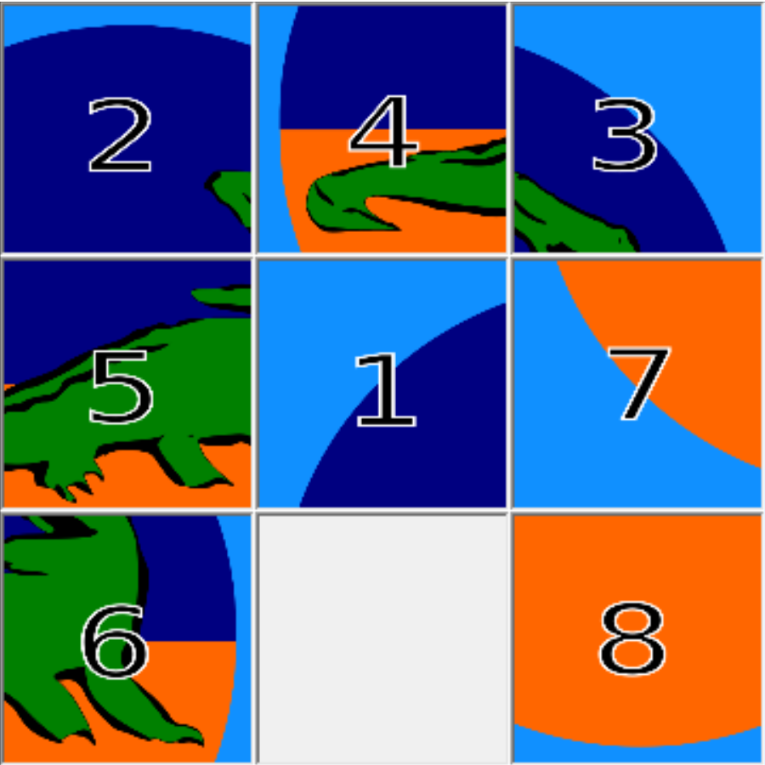
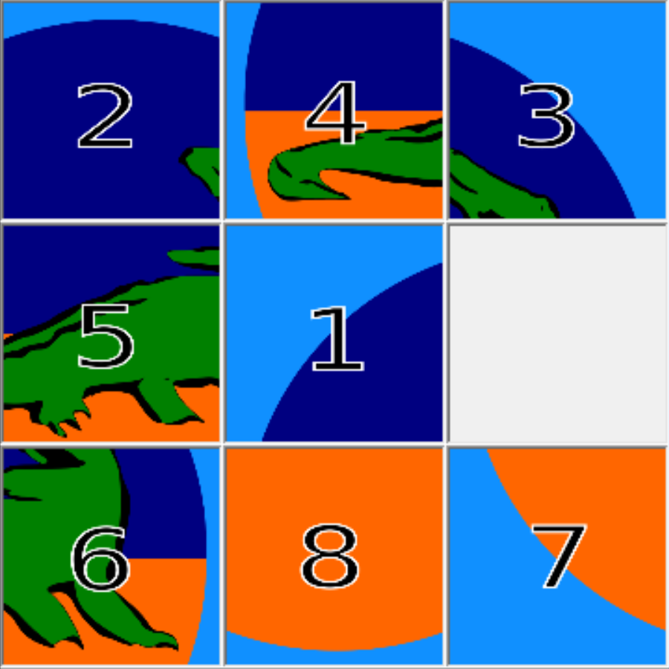
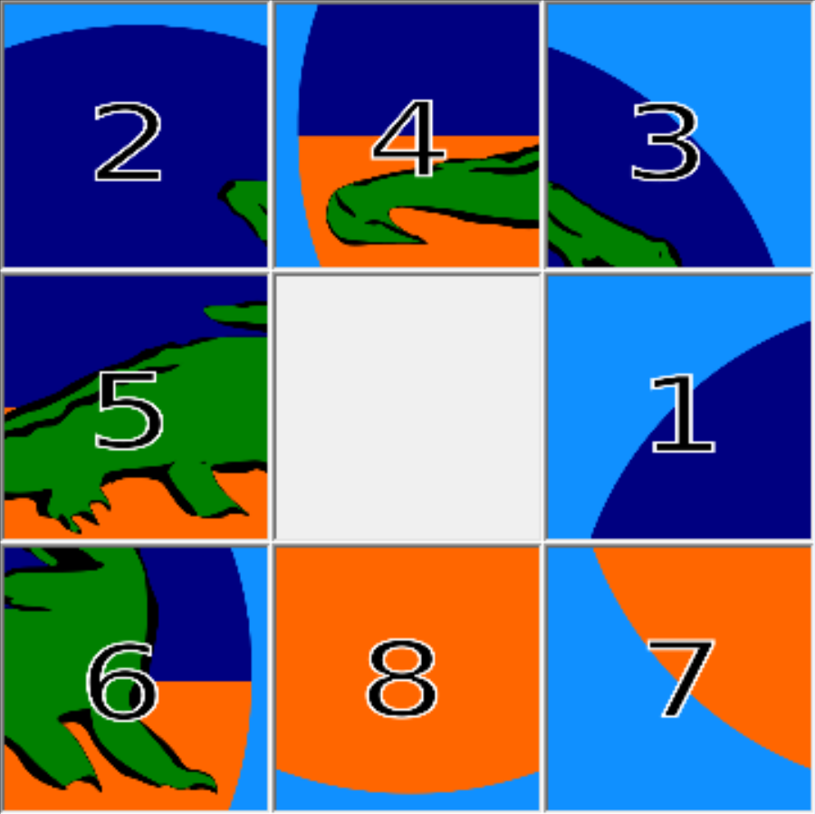
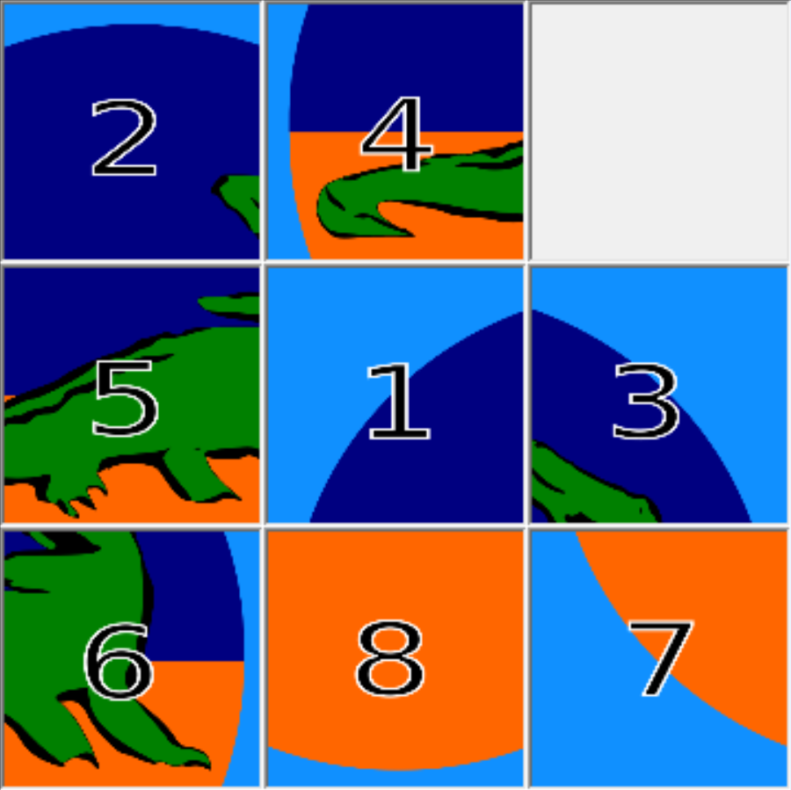
Search: The 8-Puzzle (Example)
Example:

Slide 8

Search Challenges
It turns out that a naïve, brute-force approach has some issues.
Number of Search Nodes, 10-Ply: 4¹⁰ = 1,048,576
Number of Search Nodes, 55-Ply: 4⁵⁵ = 1.3 · 10³³
Possible Board Configurations: 9! = 362,880
Why are there more search nodes than board configurations?!

Slide 9
Search Challenges
Example:
Duplicates

Slide 10

Search Challenges: Duplicate States
So, how do we get duplicates, anyway?
We can “toggle” back and forth between two states
Totally different actions can yield the same result
If we can eliminate duplicates somehow…
We’ll need less memory
We’ll need less CPU time
Scale difference: from 1.3 · 10³³ to 3.6 · 10⁵ – 28 orders of magnitude!

Slide 11
Fin

